Slide 1


SPOTIFY PLAYLIST MAKER:
GENRE CLUSTERING - ANALYSIS
Christian Sarmiento - DATA 450

Slide 2
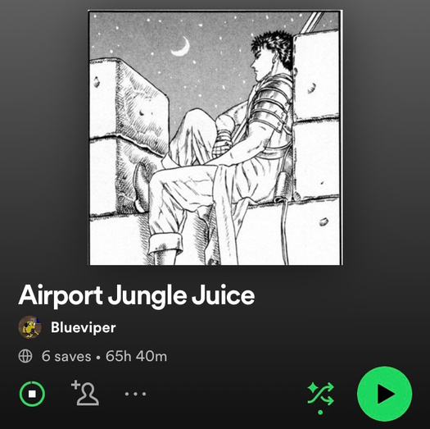
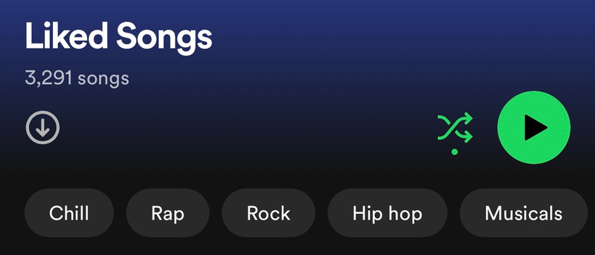

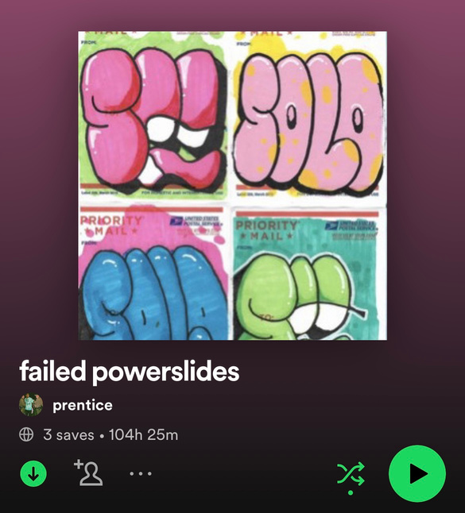
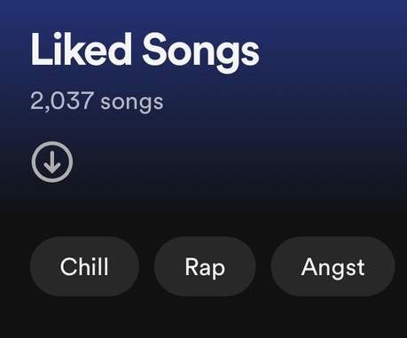
BRIEF RECAP: OUR PROBLEM
MAKING PLAYLISTS IS HARD & TIME CONSUMING
Although listening to and accumulating a lot of music is fun, listening to long playlists becomes harder the longer they are due to Spotify’s shuffling algorithm that isn’t truly random, resulting in users not being able to listen to all of the music they’ve accumulated.
This can make playlist making, an already long and tedious process, an even longer and arduous process, having to go through each song and decide if it fits the theme of the playlist you are trying to make.
Since playlist-making takes such a long time, this sometimes deters users from making playlists to begin with, resulting in shuffling through liked songs.

Slide 3


Our Solution
Spotify Data
WE ARE HERE
Model 1:
Model 2:
Model 3:
Genre Clustering
Take genre clusters and make playlists/ mixes of genres for playlists**
Classify the genre of the new playlist and develop a name for it**
New Playlist(s)
Frontend Application:
Allows users to view all possible playlists given a link and allows for selection on which ones are made**
**- Future project, details TBD

Slide 4


MODEL 1: GENRE CLUSTERING
GOAL
DATA
Evaluate which method of clustering, KMeans or Agglomerative Hierarchical Clustering, is better for implementation into our future application.
Data was sourced through Kaggle which was sourced through the Spotify API to aggregate 114,000 song records.

Slide 5


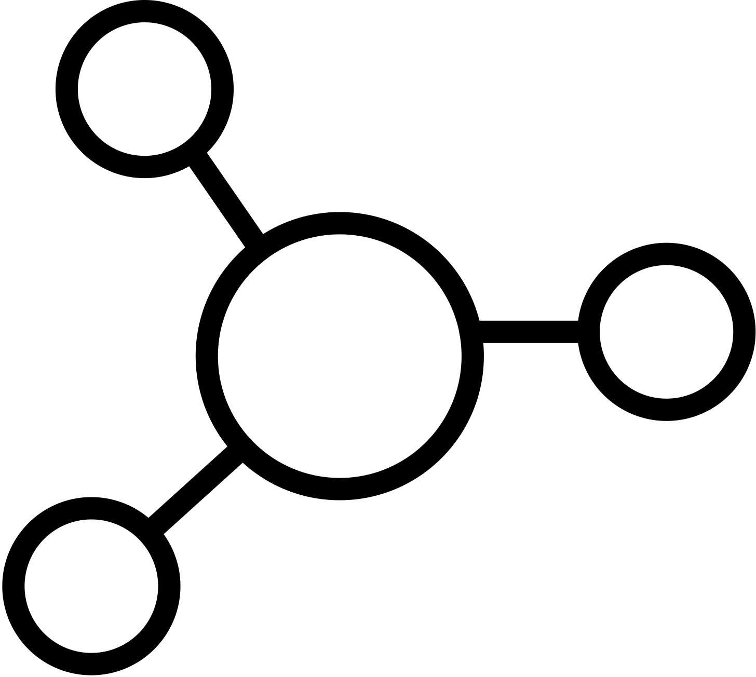
BRIEF OVERVIEW: DATA CLEANING/EXPLORATION
CLEANING
DROP ATTRIBUTES
PARTITION
114 Different Genres,
Final N = 45,671
(After Dropping Outliers/Duplicates)
Determined that we would drop attributes ‘Explicit’ & ‘Popularity’ as they have no/negative effects on our data
Also determined that we would partition the data into four separate datasets to plug into both of our models

Slide 6
Datasets
Each dataset is plugged into both models
1 PCA Dataset
n_components = 7 or optimal
Original Dataset
Scaled Dataset
3 PCA Dataset
3 PCA loadings
3 new variables
7 total attributes
‘Explicit’ & ‘Popularity’ Exist here
‘Explicit’ & ‘Popularity’ Dropped - ‘Tempo’, ‘Duration’, & ‘Loudness’ Standardized to be between 0 and 1

Slide 7
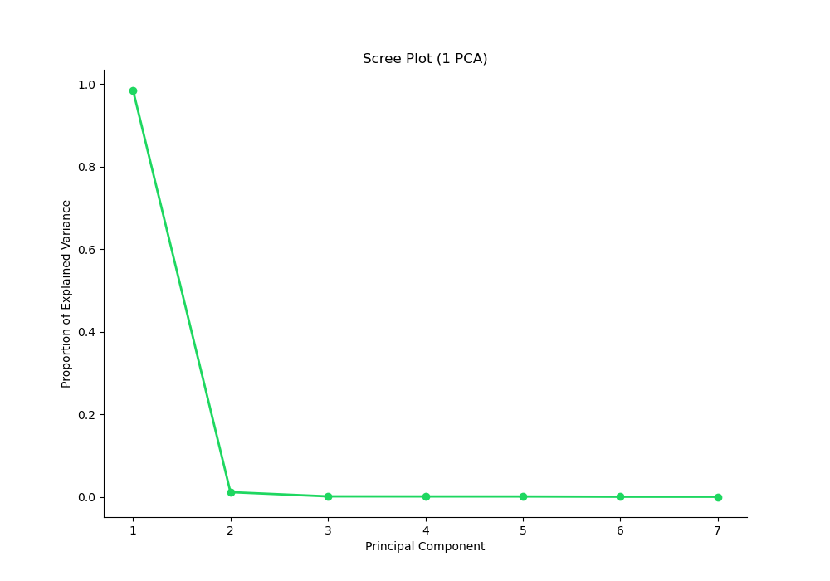
DATASETS
1 PCA
Originally did n_components = 7 because of our 3 PCA datset final attribute size

Slide 8
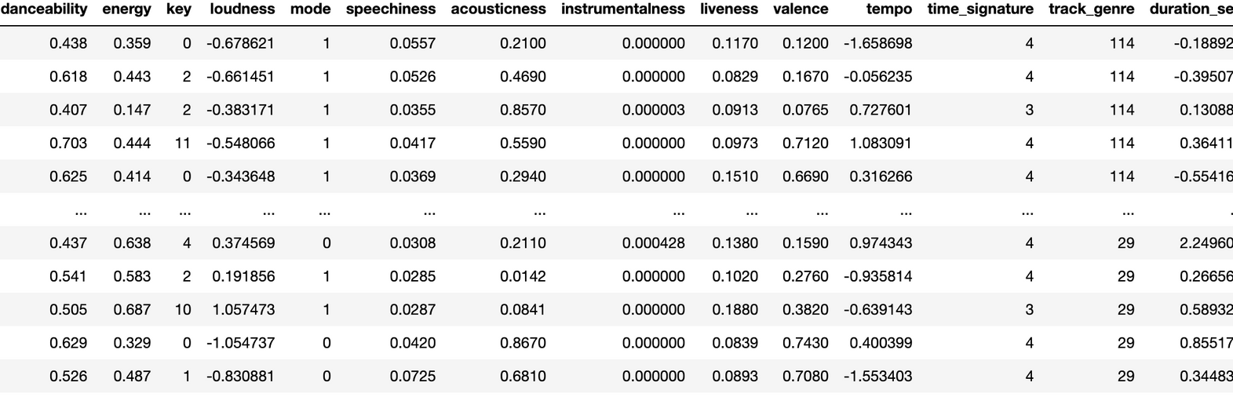
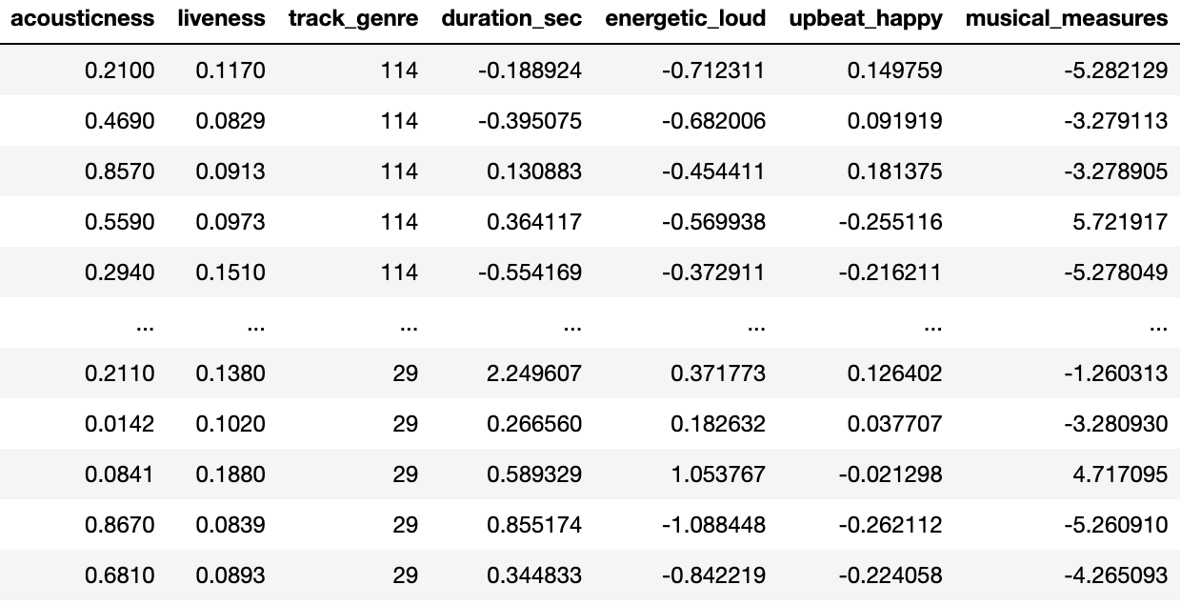
DATASETS
3 PCA

Slide 9
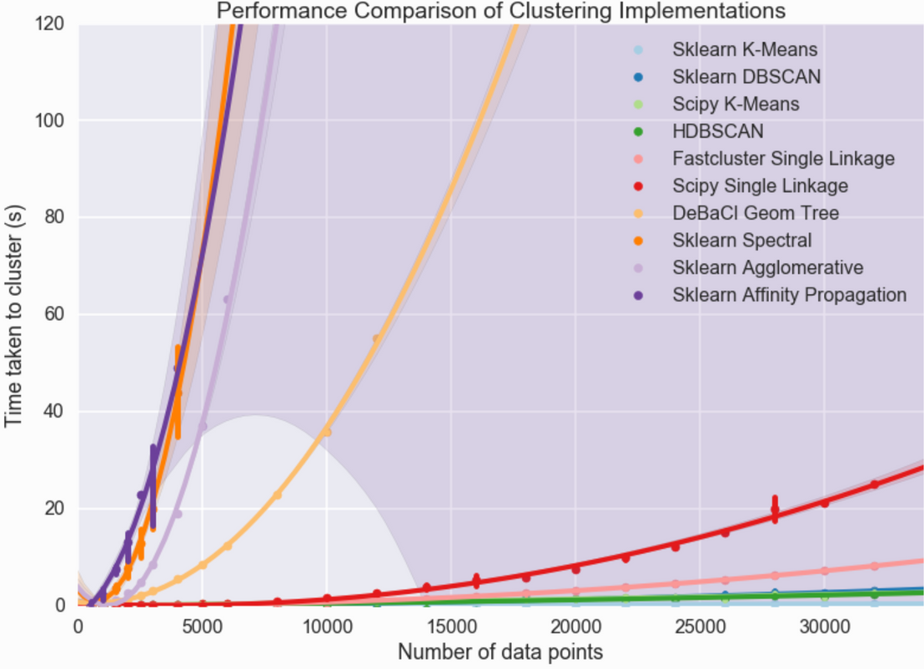
OVERVIEW
CLUSTERING
Kmeans Clustering - SciKit Learn
Faster algorithm for implementation
KMeans does not work well large K sizes (114 genres) and deviating from this number means redefining what a genre means which becomes very subjective
Must look at groups as playlists instead to avoid regrouping
Allows for mixes of genres
Agglomerative Hierarichal Clustering - SciPy
2nd Fastest Hierarichal Clustering Algorithm, still not faster than KMeans
Starts at one data point, clusters up which implies that it could find groups of genres better than KMeans can (theoretically)
Source: https://hdbscan.readthedocs.io/en/latest/performance_and_scalability.html

Slide 10
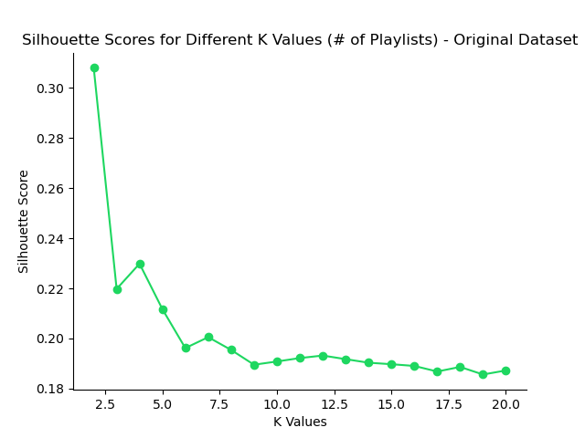
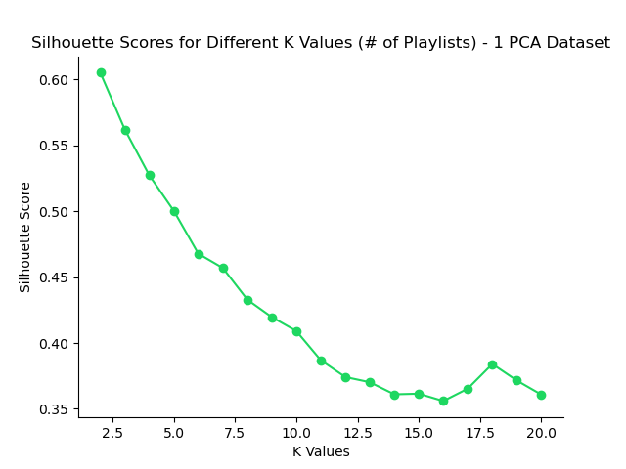
CLUSTERING
KMEANS
Showing Original as a Benchmark & Highest Silhouette Score Scores as the Plots Do Not Vary Much

Slide 11
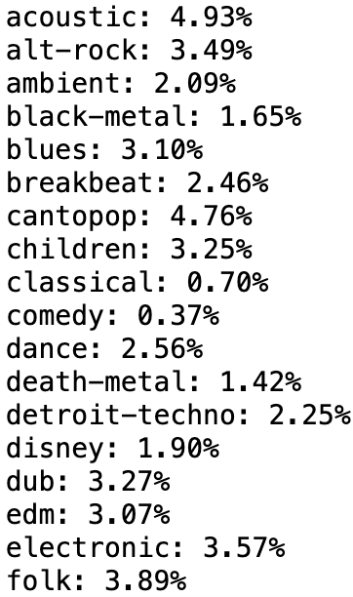
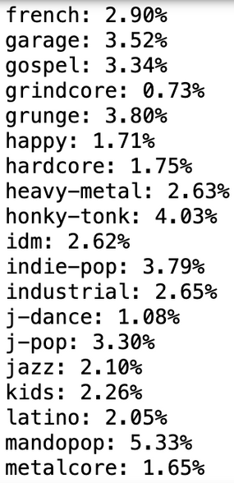
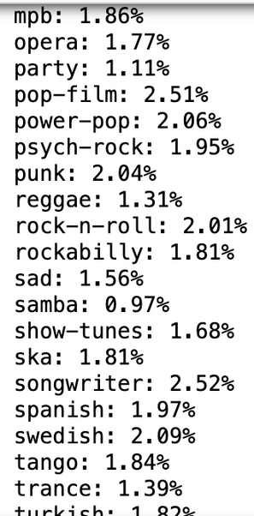
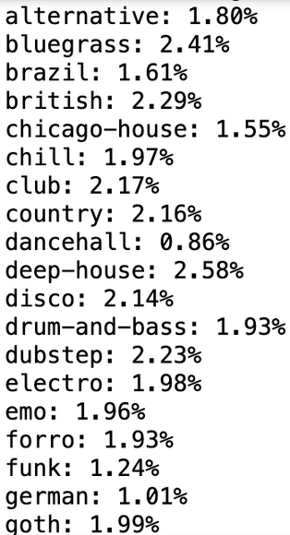
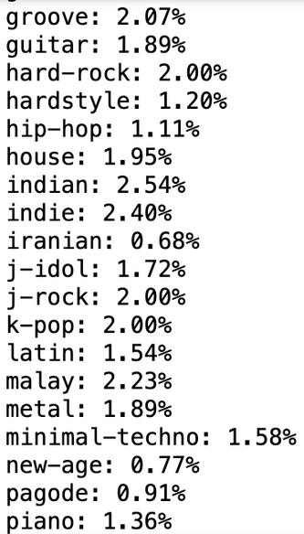
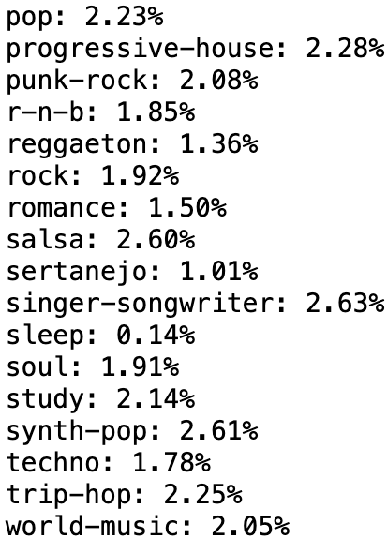
CLUSTERING
KMEANS CLUSTER SAMPLES
Looking at our most consistent cluster according to our Silhouette Score, K = 2
Cluster 1
Cluster 2
Hard to tell without listening to the music, but seems to be grouped by mood - We have some odd mixes together though such as Death Metal and Disney (not shown here, but this is a common occurrence among other K sizes). KMeans seems to generalize into two large moods: more moody music, slower and more upbeat music.

Slide 12
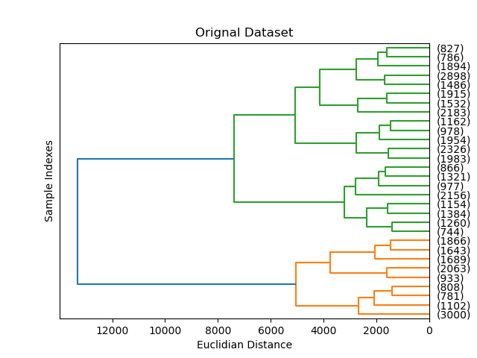
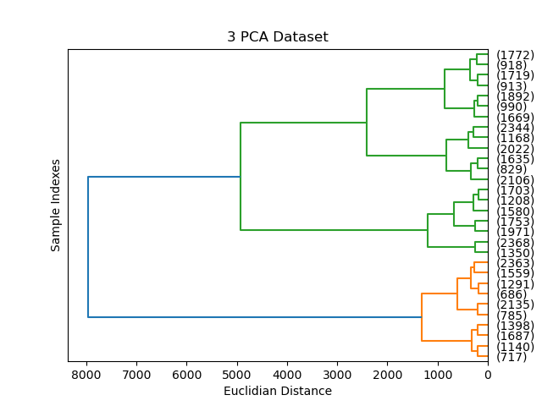
CLUSTERING
HIERARCHIAL AGGLOMERATIVE - WARD’S LINKAGE
Showing Original as a Benchmark & Highest Cophenetic Correlation Coefficient as the Plots Do Not Vary Much
Note: Cophenetic Correlation Coefficient is a measure of how concise and good our clusters are given distance and dissimilarity in relation to the distance between the original data points.
Cophenetic Correlation Coefficient = .52
Cophenetic Correlation Coefficient = .74
Here, we can see that our Hierarchical clustering clustered our music in a similar way to KMeans where the groups are moods. Looking more into the samples, we can see that it is still representative of mood rather than genre.

Slide 13
CLUSTERING
OVERVIEW
KMeans
Cluster groups were consistent and expected
As we go up in K size we lose consistency, but not too much
Playlists would be mixes of moods
In the future we can work towards looking into different ways to store music data to get more detailed groupings of moods within playlists
Agglomerative Hierarchical - Ward’s Linkage
Results unexpected - expected groupings to be based more on genre but in hindsight, it makes sense that we have groupings based on mood due to how detailed our attributes are
Despite unexpected results, our clusters are still very cohesive - possibly more cohesive than KMeans clustering given our large Cophenetic Correlation Coefficient (.74 w/ 3 PCA Dataset)
Again, might be viable to look into different attributes/music data to get closer to clusters of actual genres, even if the genres are defined on their mood

Slide 14
CLUSTERING
OVERVIEW
Future Developments
Looking into different types of Spotify datasets/attributes (if applicable) to get different views of the music, possibly even directly porting their API into our analysis to play with different sections of the data.
Overall, looking into ways in which we can get our models to not generalize too much to get different, more detailed groups of the different moods that can be found within a given playlist
Possibly pursuing a survey study to understand listening behavior more as there is a lack of information surrounding how users make and interact with playlists on the app. This would give us more insight into listening habits and can help us not only support our claims of playlist making being hard to do but also to identify other vulnerabilities and inefficiencies within the app experience

Slide 15
Questions?

